Slide 1

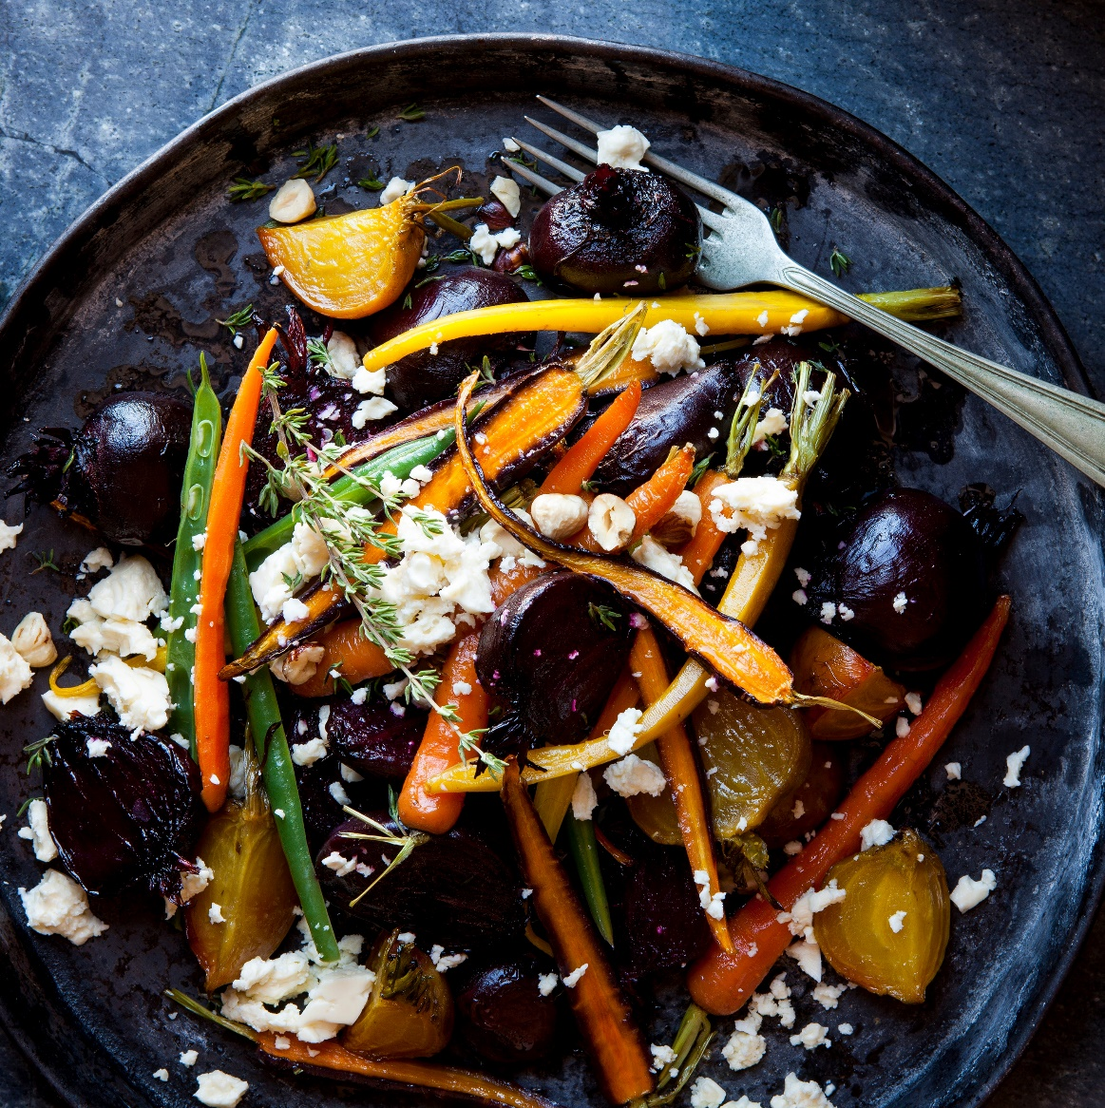
MealMate
SAVE RECIPES, TRACK NUTRITION, LIVE HEALTHILY.
COLIN, ELIOTT, HUI, LUCY, SHUYUAN

Slide 2
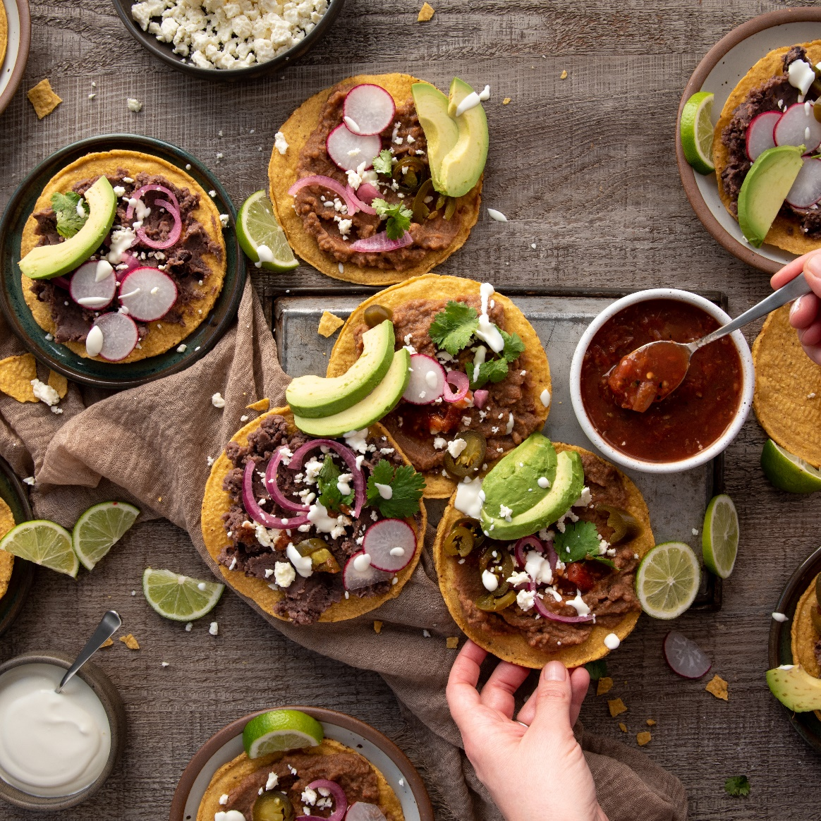
About
MEAL TRACKER APP THAT LETS YOU SAVE RECIPES AND THE DIFFERENT INGREDIENTS IN IT. IT SHOWS YOU THE TOTAL CALORIES WITH THE NUTRITION FACTS.

Slide 3
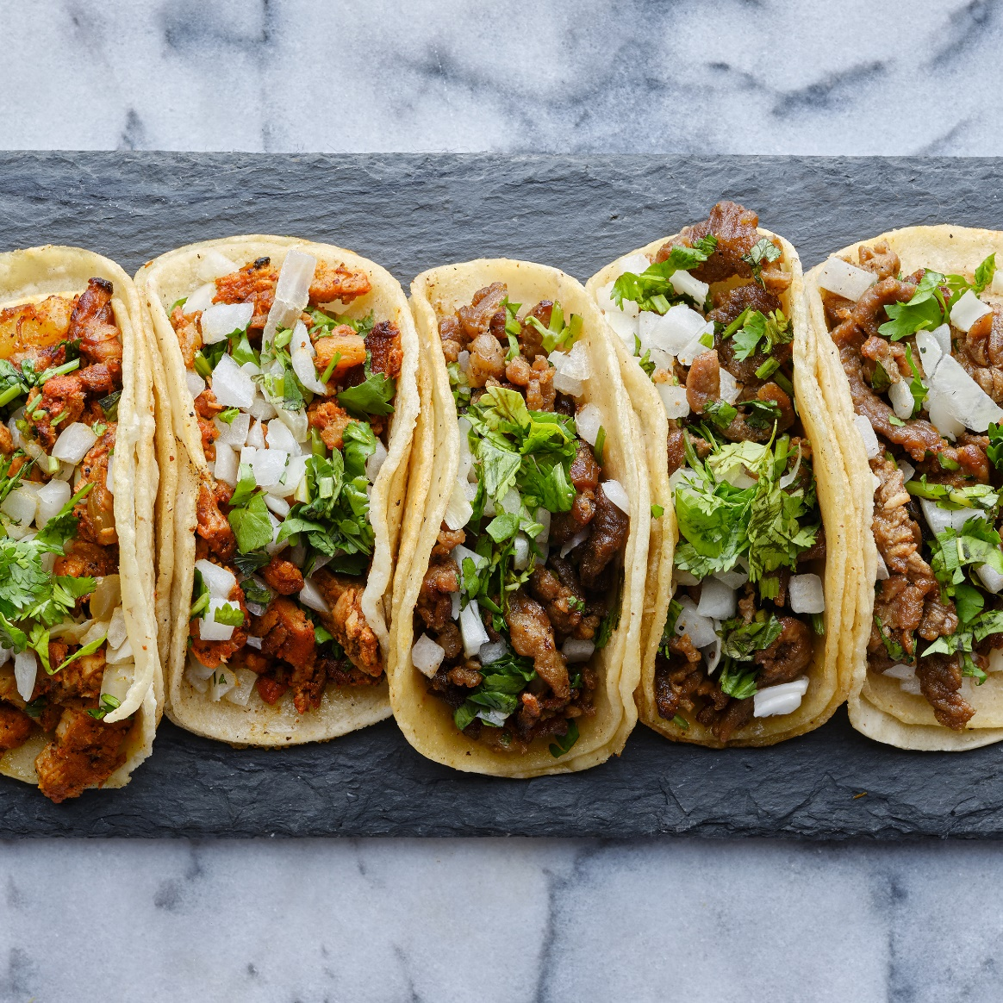
Customer
INDIVIDUALS WHOSE GOALS ARE TO EAT HEALTHILY AND KEEP TRACK OF MEALS.
Notes:
Fitness enthusiasts, home cooks, parents, etc.

Slide 4
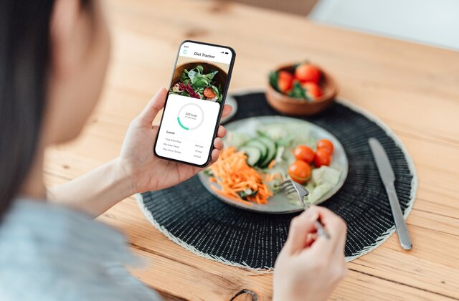
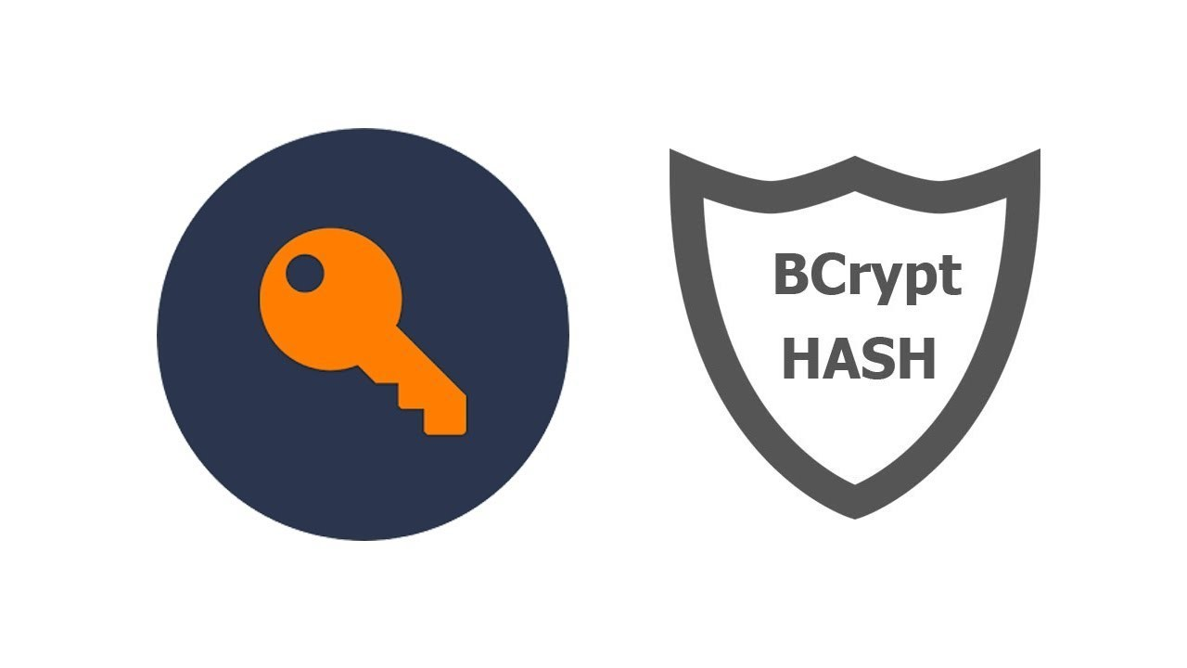
User
Register
Enter Info
Get ID
Login
ID
Password
Enjoy!

Slide 5
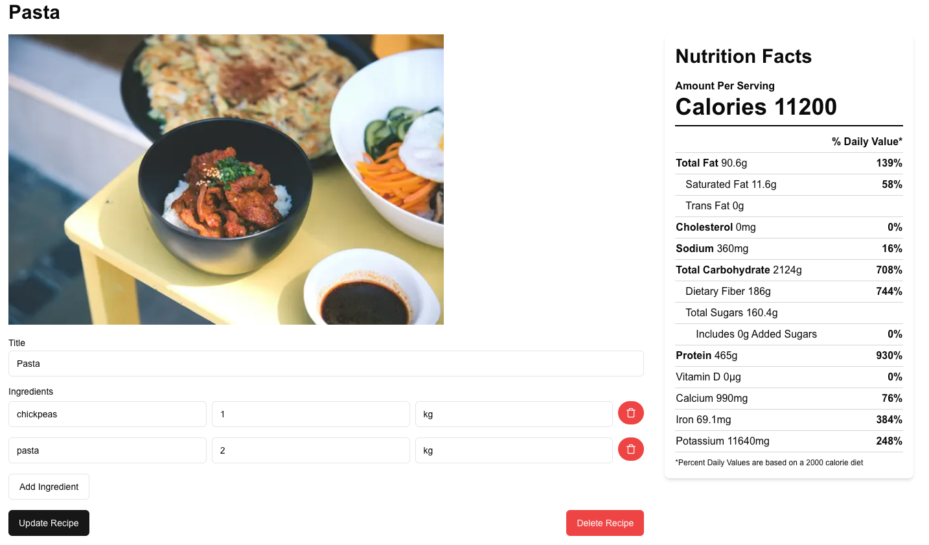


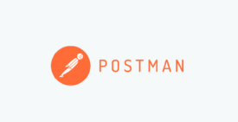

Frontend: Postman for Development / Tests + React
Backend: Spring Boot/MVC, JDBC Template
DTO/DAO/Mapper/Service/Controller: User, Recipe, Nutrient, Ingredient
Database Schema: User, Recipe, Nutrient, Ingredient, recipeIngredient
Endpoints: GET, POST, PUT, DELETE
Notes:
GET /recipes/recipeId
POST /recipes
PUT /recipes/recipeId
DELETE /recipes/recipeId

Slide 6
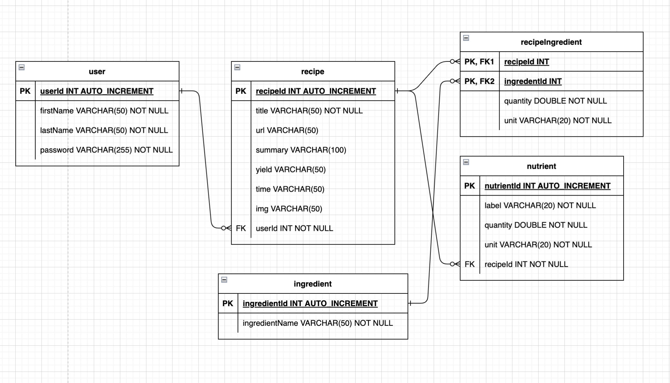
ERD Diagram

Slide 7
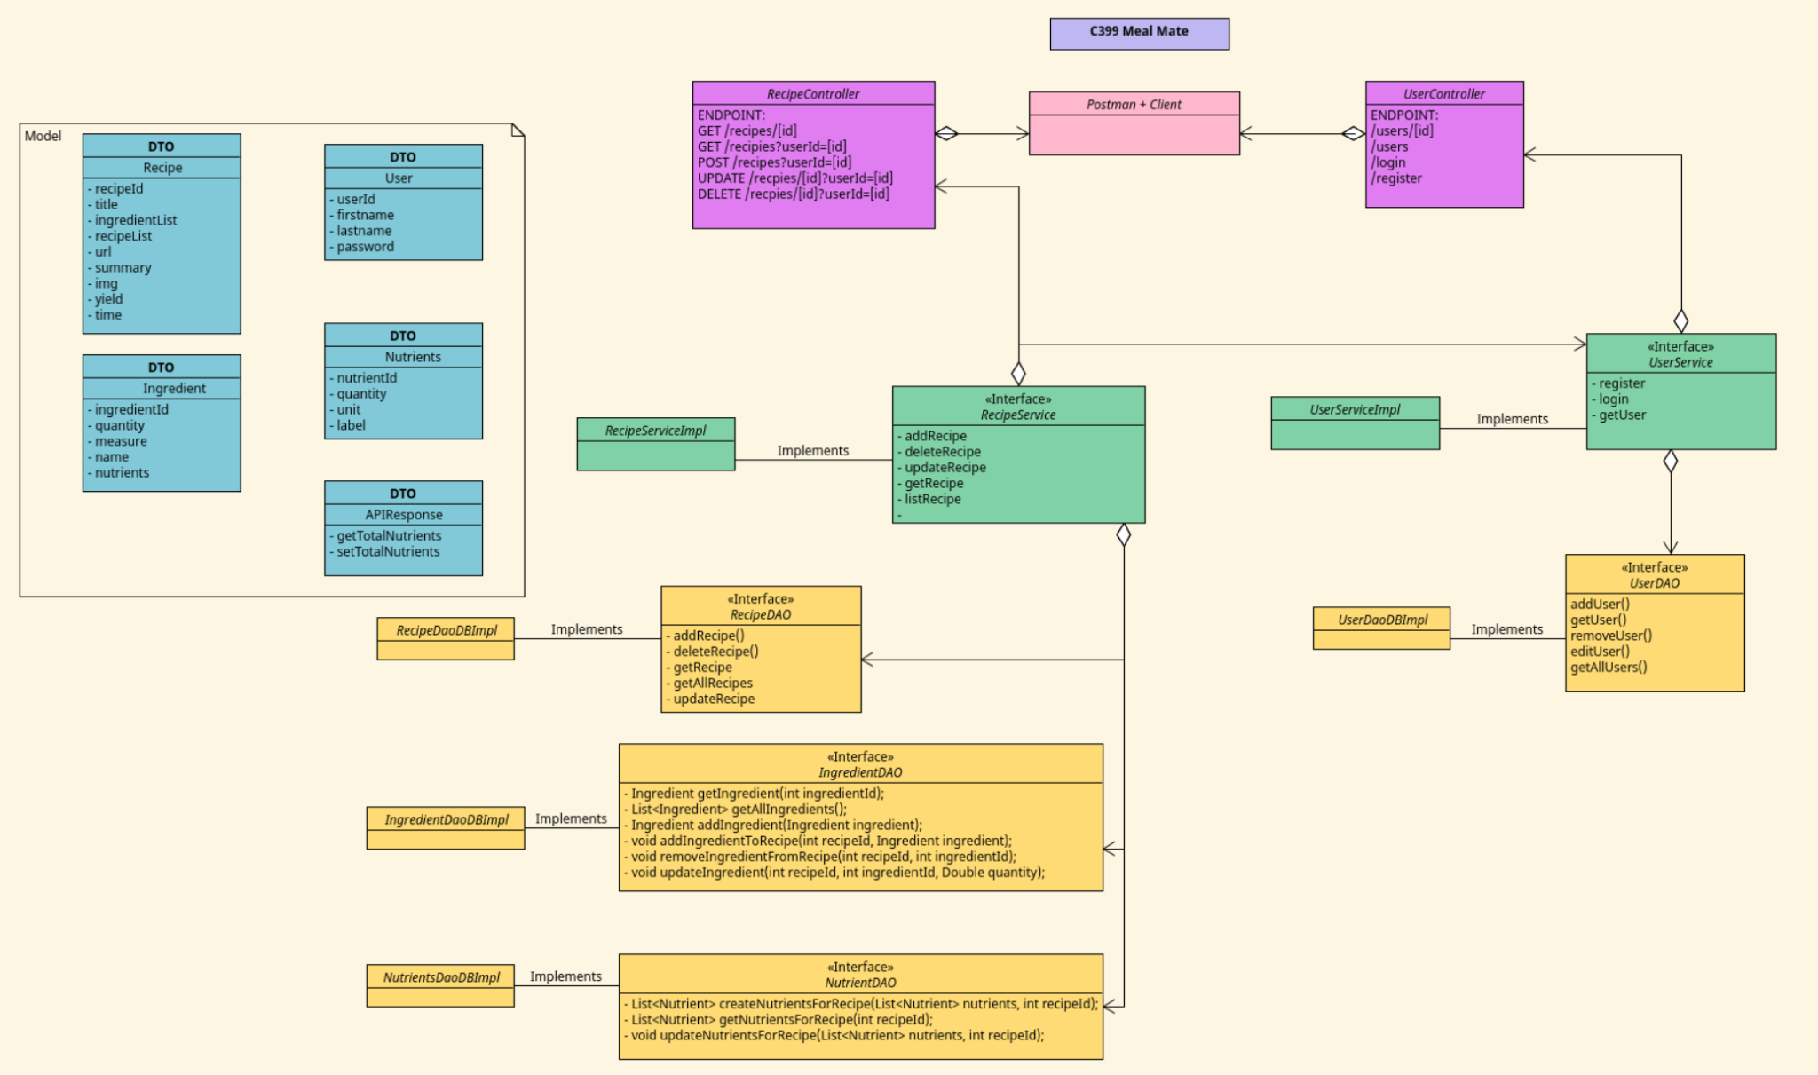
UML Diagram

Slide 8
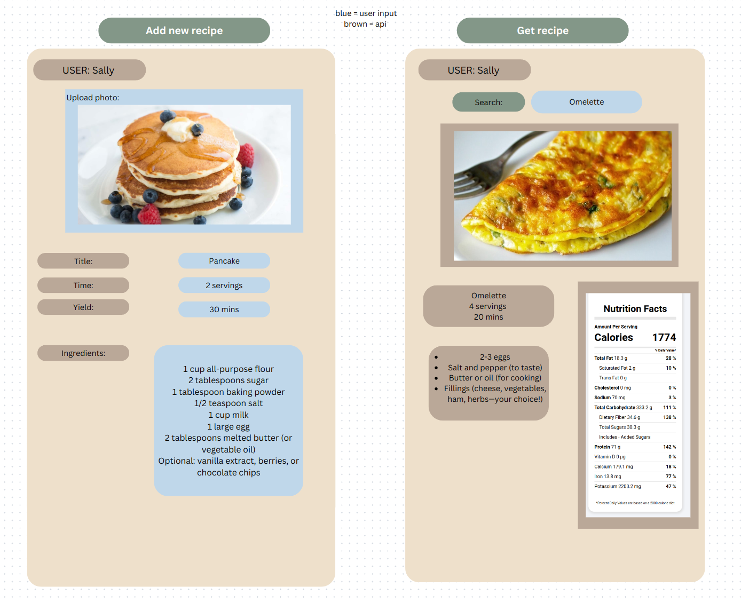
UI Mockup
Brown = api
Blue = ui

Slide 9

API
EDAMAM
FULL ANALYSIS OF FOOD RECIPES IN REAL TIME.
https://api.edamam.com/doc/open-api/nutrition-analysis-v1.yaml
Notes:
Submit the full text of any recipe or ingredient list
Edamam will extract the full nutrition and ingredient data from the text
Edamam returns data for calories, fats, carbohydrates, protein, cholesterol, sodium, etc. for a total of 28 macro and micronutrients

Slide 10
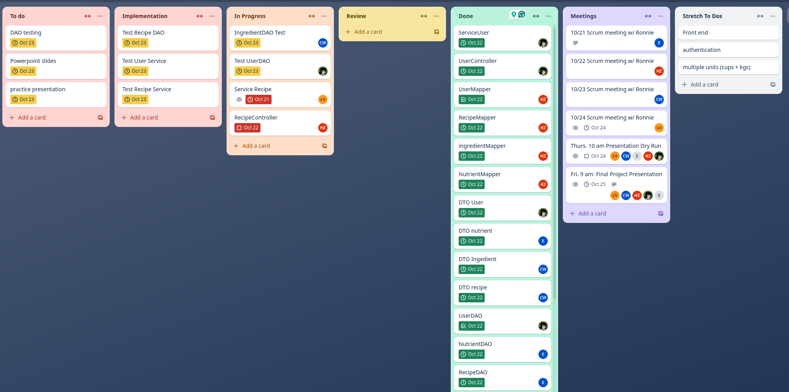
Assignment Distribution: Trello

Slide 11
Lessons Learned
Backend/ spring / jdbc / mysql
Collaboration & team work
Git, Github pull requests
Organize tasks so that one can work on a task without causing issues with someone else

Slide 12

DEMO

Slide 13


